Slide 1

EnerGauge: The Futurecast Model for Demand Dynamics
SANJAY P

Slide 2
CONTENTS
ABSTRACT
INTRODUCTION
EXISTING METHOD
PROPOSED SYSTEM
ALGORITHMS & TECHNIQUES
FINAL OUTCOME

Slide 3
ABSTRACT
Energy demand prediction can benefit electricity consumers, distribution network service providers, and system operators. It heavily depends on auxiliary factors, such as weather parameters (e.g., ambient temperature), which makes this problem more complex. Moreover, for many industrial applications, instead of aiming for the highest prediction accuracy, a more easily understandable and interpretable model that can lead to higher accuracy against the baseline model is the priority. Therefore, this problem still requires more investigation, especially when there is a specified prediction baseline to be compared with. This paper proposes a machine learning (ML)prediction framework that investigates how temperature combined with energy consumption and simple and interpretable ML methods can be used to provide more precise demand forecasts and thus baselines closer to actual load profiles. The proposed framework is tested on two different real-world energy demand datasets. The analysis shows that using a simple ML model, such as a models linear regression, random forest and LSTM based, results in a more accurate prediction than the current baselines used in the energy market. The proposed ML models are not black-box type models, and thus are easier to explain and interpret. The ML-based forecasted demand is used as a baseline for demand response (DR) and is compared with the existing baselines used in the demand response Spain. Consumption and generation data was retrieved from ENTSOE a public portal.

Slide 4
INTRODUCTION
The project titled “EnerGauge: The Futurecast Model for Demand Dynamics” aims to develop a comprehensive model for forecasting and predicting energy demand. This innovative approach seeks to address the growing need for accurate energy demand projections in a world where energy consumption patterns are rapidly evolving due to technological advancements, policy changes, and shifts in consumer behaviour.
The project incorporates the Long Short-Term Memory (LSTM) model, a specialized form of recurrent neural network (RNN), to predict energy demand. The LSTM model is particularly well-suited for forecasting tasks where understanding long-term dependencies is crucial. Unlike standard feedforward neural networks, LSTMs have feedback connections that allow them to process not just single data points, but entire sequences of data.

Slide 5
Existing Method
Overview
Machine Learning Framework: Proposes a machine learning (ML) based prediction framework to forecast energy demand using temperature, energy consumption, and simple ML methods1.
Interpretable Models: Focuses on interpretable models like linear and polynomial regression for better understanding and accuracy compared to baseline models.
Real-world Data: Validates the framework with two real-world energy demand datasets, showing improved accuracy over current market baselines

Slide 6
Potential Disadvantages:
Complexity for Users: While the models aim for simplicity, users without technical expertise may still find them complex.
Data Dependency: The accuracy of predictions heavily relies on the quality and relevance of historical data and auxiliary factors.
Model Limitations: Simple ML models may not capture all complexities of energy demand, potentially limiting prediction accuracy in certain scenarios.
Future Work: The paper suggests further research is needed to incorporate tariff structures and validate monetary benefits, indicating current limitations in these areas

Slide 7
Proposed Method
Data Understanding and Preprocessing: You've started by loading datasets related to energy consumption and weather, understanding their structure, handling missing values, and visualizing key features over time. This step is crucial as it sets the foundation for further analysis.
Exploratory Data Analysis (EDA): my EDA includes visualizations such as line plots, heatmaps, pair plots, and distribution plots to understand the relationships between different variables and how they evolve over time. These visualizations help identify patterns, correlations, and potential outliers in the data.

Slide 8
Machine Learning Modeling:
Linear Regression: You've applied linear regression to predict energy load based on features like biomass generation, solar generation, and forecasted solar generation. You've evaluated the model using metrics like mean squared error and R-squared.
Random Forest Regression: Another model you've used to predict temperature based on various weather features. Random forest regression often handles non-linear relationships well and can capture complex interactions between features.
LSTM (Long Short-Term Memory): LSTM is a type of recurrent neural network (RNN) commonly used for sequential data like time series. You've implemented an LSTM model to forecast energy consumption based on historical energy data.
Model Evaluation: You've evaluated the performance of my machine learning models using metrics such as mean squared error and R-squared for regression tasks. These metrics provide insights into how well the models are performing and help in comparing different models.
Predictive Analysis: You've utilized trained models to make predictions on unseen data, such as forecasting future energy load or temperature based on the learned patterns.

Slide 9
Complexity for Users: While the models themselves may still be complex, you've provided clear explanations and visualizations throughout my code. This can help users, even those without technical expertise, to understand the process and the results better.
Data Dependency: By utilizing machine learning models trained on historical data, my code attempts to mitigate data dependency issues. These models can learn patterns and relationships from past data, potentially improving prediction accuracy even in the presence of noisy or incomplete data.
Model Limitations: My code employs a variety of machine learning techniques, including linear regression, random forest regression, and LSTM neural networks. These models vary in complexity and capability, allowing you to capture different aspects of the data and potentially address some of the limitations of simpler models.
Future Work: While My code may not explicitly address the need for further research, it provides a framework for conducting such research. By exploring different models, evaluating their performance, and identifying areas for improvement, you can iteratively refine my approach and address any existing limitations.

Slide 10
Advantages:
Insight Generation: Through my analysis, you can gain insights into the factors influencing energy consumption and weather patterns.
Forecasting: By building predictive models, you can forecast future energy demand and weather conditions, which can be valuable for planning and decision-making.
Optimization: Understanding energy consumption patterns can help in optimizing resource allocation, improving efficiency, and reducing costs.
Adaptation: With accurate forecasts, stakeholders can better adapt to changing energy demands and weather conditions, leading to improved resilience and sustainability.

Slide 11
FUTURE ENHANCEMENT
Linear Regression:
Disadvantages:
Linear regression assumes a linear relationship between the independent and dependent variables. It may not capture complex nonlinear relationships in the data.
It is sensitive to outliers and can be influenced by them, potentially leading to biased estimates.
It may not perform well if the underlying assumptions of linear regression (such as multicollinearity, homoscedasticity, and independence of errors) are violated.
Random Forest Regression:
Disadvantages:
Random forests can be computationally expensive, especially for large datasets and a large number of trees.
They are not easily interpretable compared to simpler models like linear regression.
Random forests may overfit the training data if hyperparameters are not properly tuned, leading to reduced generalization performance on unseen data.

Slide 12
Long Short-Term Memory (LSTM):
Disadvantages:
LSTMs require a large amount of training data to learn effectively, which may be challenging to obtain in some domains.
They can be computationally expensive to train, especially for deep architectures and long sequences.

Slide 13
Algorithm & Techniques
Linear Regression:
Algorithm: Linear regression is a simple algorithm used for supervised learning tasks, particularly for regression problems.
Technique: It fits a linear model to the relationship between the independent variables (features) and the dependent variable (target) by minimizing the sum of the squared differences between the observed and predicted values.
Random Forest Regression:
Algorithm: Random forest is an ensemble learning algorithm based on decision trees. It builds multiple decision trees and combines their predictions to improve accuracy and reduce overfitting.
Technique: In random forest regression, each tree is trained on a random subset of the data and a random subset of features. The final prediction is the average (or mode) of predictions from individual trees.
Long Short-Term Memory (LSTM):
Algorithm: LSTM is a type of recurrent neural network (RNN) designed to handle sequential data, such as time series or natural language.
Technique: LSTM networks have a special architecture with memory cells and gates that allow them to learn long-term dependencies in data. They can retain information over long sequences, making them suitable for time series forecasting tasks.

Slide 14
Data Preprocessing:
Technique: Data preprocessing techniques like filling missing values with forward filling (method='ffill'), scaling features to a specified range (using MinMaxScaler), and resampling time series data to a lower frequency (using resample) are used to prepare the data for modeling.
Visualization:
Technique: Visualization techniques like line plots, heatmaps, pair plots, and distribution plots are used to explore and understand the relationships between variables, identify patterns, and visualize model predictions.
Train-Test Split:
Technique: The dataset is split into training and testing sets using the train_test_split function from scikit-learn. This allows for model evaluation on unseen data to assess generalization performance.
Model Evaluation:
Technique: Model performance is evaluated using metrics such as mean squared error (MSE) and R-squared score (mean_squared_error, r2_score). These metrics quantify the accuracy and goodness of fit of the models to the data.

Slide 15
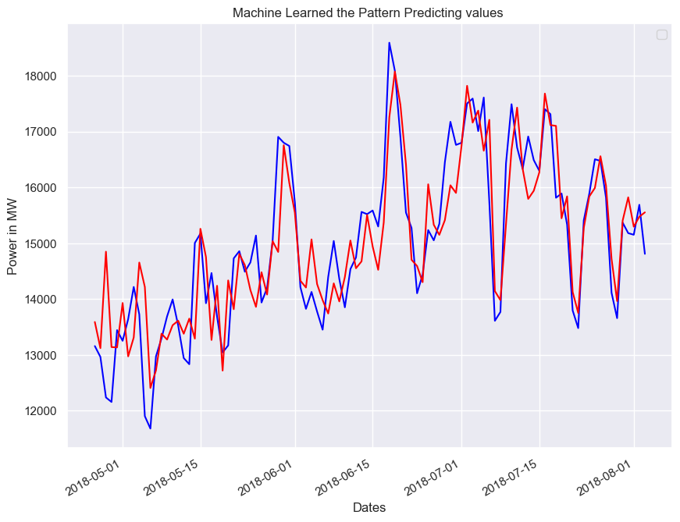
Final Outcome

